Slide 1
UTERUS AND UTERINE TUBE
BY
DR. F.O IGELIGE

Slide 2
UTERUS
uterus is a pear-shaped organ in the reproductive system of females. It’s where a fertilized egg implants during pregnancy and where the baby develops until birth. It’s also responsible for your menstrual cycle
It’s hollow and muscular and sits between the rectum and bladder in the pelvis.
uterus is in the pelvis between the bladder and rectum. It’s supported by pelvic floor muscles and perineal body. Ligaments in the pelvis, lower back and hips also help hold the uterus in place.

Slide 3
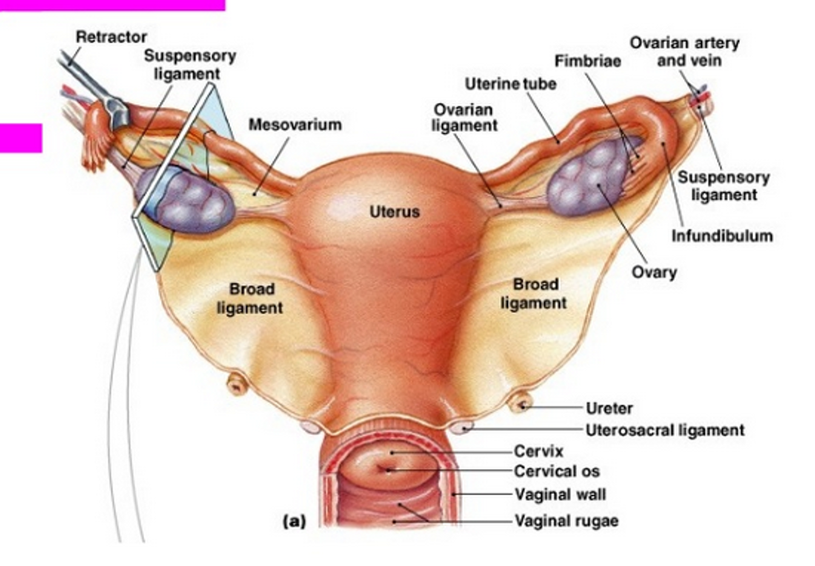

Slide 4
Function
uterus plays a key role in your reproductive health and function. The three main jobs of the uterus are:
Pregnancy. uterus stretches to grow the baby during pregnancy. It can also contract to help push the baby out of the vagina.
Fertility. uterus is where a fertilized egg implants during conception and where your baby grows.
Menstrual cycle. uterine lining is where blood and tissue come from during menstruation.

Slide 5
uterus consists of three layers:
Perimetrium. The outermost, protective layer.
Myometrium. The highly muscular middle layer. This is what expands during pregnancy and contracts to push your baby out.
Endometrium. The inner layer or lining of your uterus (uterine lining). This layer of your uterus is shed during your menstrual cycle.

Slide 6
The uterus during menstruation.
During menstrual cycle, the lining of the goes through several changes. The lining (called the endometrial lining) gets thicker and rich with blood as you near ovulation (releasing an egg from the ovaries).
If an egg is fertilized during that cycle, it implants into the lining of uterus, and pregnancy begins.
endometrial lining sheds if pregnancy doesn’t happen (this is the period). This process repeats every menstrual cycle unless pregnancy occurs.

Slide 7
The uterus during pregnancy.
If conception (when the egg is fertilized by sperm) occurs during menstrual cycle, the fertilized egg implants into the uterine lining.
The fertilized egg (called a blastocyte) burrows into the endometrial lining of the uterus (implantation).
This is when pregnancy officially begins, and misses menstrual period.
uterus grows and stretches like a balloon to accommodate growing baby. It contracts during labor and delivery to help push baby out of the vagina.
After about six weeks, uterus returns to its pre-pregnancy size (although, it can be slightly larger and show signs of being stretched).

Slide 8
The size of the uterus
uterus is about 3 inches from top to bottom and 2 inches wide at the widest part. It’s about 1 inch thick and weighs around 1 ounce.
Size of the uterus during pregnancy
uterus is one of the most unique organs in the body. It can stretch from the size of a lemon to the size of a watermelon during pregnancy.
uterus can be up to 2 pounds when baby is born.
uterus shrinks down to its normal size (a process called involution) and position about six weeks postpartum (after giving birth).

Slide 9
uterus looks like a light bulb. It’s about the size of a fist. It’s also commonly described as an upside-down pear.
uterus has two horn-like organs at the top (the fallopian tubes). It connects to cervix at the bottom, which is the part that opens (dilates) during vaginal delivery.
uterus has several sections:
Fundus. The uppermost and widest part of uterus. It connects to fallopian tubes.
Corpus. The main body of uterus. This is where a fertilized egg implants during pregnancy.
Isthmus. The part of uterus between corpus and cervix. It’s where the uterus starts to narrow or thin.
Cervix. The lowest part of uterus. cervix opens to vagina.

Slide 10
the positions of the uterus
uterus can lie in several positions. A typical uterus tilts forward at the cervix and points towards the abdomen. This is called an anteverted uterus. Most people have an anteverted uterus.
If you don’t have an anteverted uterus, you might have a:
Retroverted uterus. Commonly called a tipped or tilted uterus. This is when uterus is tilted or tipped backward so it curves toward the spine instead of forward toward your abdomen.
Anteflexed uterus. uterus is anteflexed when it’s bent forward. The tilt is severe and can put pressure on abdomen or bladder and cause painful symptoms
Retroflexed uterus. uterus is retroflexed when it’s bent backward. The tilt puts pressure on the lower back.
An individual may never know you have an irregularly shaped uterus if you don’t have symptoms. In some cases, you’ll have symptoms that require treatment by your healthcare provider.

Slide 11
common conditions of the uterus
Several health conditions can be associated with uterus. Some of the most common conditions are:
Uterine fibroids. Small, noncancerous tumors in the uterus.
Uterine polyps. Growths in the endometrial lining of the uterus.
Uterine cancer. Cancer of the uterus, such as endometrial cancer or uterine sarcoma.
Endometriosis. A condition when the uterine lining grows in places other than uterus.
Pelvic inflammatory disease. An infection of the reproductive organs.
Uterine prolapse. A condition where the uterus slips out of position.
Infertility. The inability to get pregnant.

Slide 12
INTRODUCTION
The uterine tubes (or fallopian tubes, oviducts, salpinx) are muscular ‘J-shaped’ tubes, found in the female reproductive tract.
They lie in the upper border of the broad ligament, extending laterally from the uterus, opening into the abdominal cavity, near the ovaries.

Slide 13
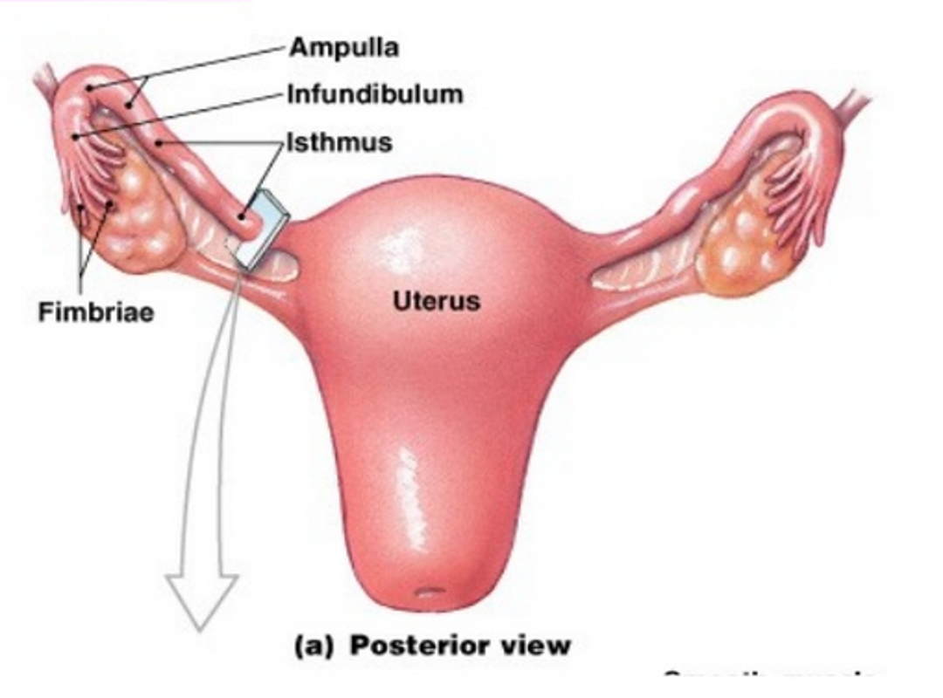

Slide 14
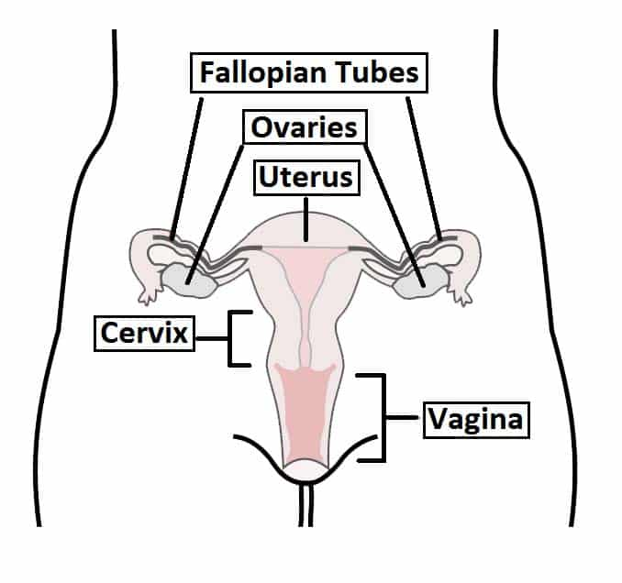
Overview of the female reproductive tract.

Slide 15
Relations
Anterior, posterior and superior - In front of, behind and above the uterine tubes are peritoneum cavity and intestines
Lateral - On either side of the uterine tubes are the side walls of the pelvis
Inferior - The broad ligaments and ovaries lie below the uterine tubes
Medial - The uterus lies below the two uterine tubes

Slide 16
Supports
The uterine tubes are held in place by their attachment to the uterus
The peritoneum folds over them as the broad ligaments and extend at the sides to form the infundibulo pelvic ligaments

Slide 17
Structure
The tube is 10 to 13 cm long
The lumen of the tube provides a pathway from outside to the peritoneum cavity
The uterine tube has 4 portions
The interstitial portion is 1.25 cm long and lies within the walls of the uterus
Its lumen is 1 mm wide
The Isthmus is another narrow part which extends to 2.5 cm from the uterus
The Ampulla is the wider portion 5 cm long where fertilization usually occur
The infundibulum is the funnel-shaped fringed end which is composed of many processes known as fimbriae
One fimbria is elongated to form the ovarian fimbria which is attached to the ovary

Slide 18
Layers
The lining - This is a mucous membrane of ciliated cubical epithelium that are thrown into folds known as plicae
These folds slow the movement of the ovum on its way to the uterus
The cells in the lining produce a secretion containing glycogen which nourishes the ovum
Beneath the lining is a layer of vascular connective tissue
The muscle coat - This consists of two layers of smooth muscles an inner circular layer and outer longitudinal layer
The peristaltic movement of the tube is due to these muscles.
The tube is covered with peritoneum

Slide 19
Functions
The main function of the uterine tubes is to assist in the transfer and transport of the ovum from the ovary to the uterus.
The ultrastructure of the uterine tubes facilitates the movement of the female gamete:
The inner mucosa is lined with ciliated columnar epithelial cells and peg cells (non-ciliated secretory cells). They waft the ovum towards the uterus and supply it with nutrients.
Smooth muscle layer contracts to assist with transportation of the ova and sperm. Muscle is sensitive to sex steroids, and thus peristalsis is greatest when oestrogen levels are high.
Functions
Propels the ovum towards the uterus
Receives the spermatozoa
Provide a site for fertilization
It supplies the fertilized ovum with nutrition during its journey to the uterus

Slide 20
Anatomical Structure
The fallopian tube is described as having four parts (lateral to medial):
Fimbriae – finger-like, ciliated projections which capture the ovum from the surface of the ovary.
Infundibulum – funnel-shaped opening near the ovary to which fimbriae are attached.
Ampulla – widest section of the uterine tubes. Fertilization usually occurs here.
Isthmus – narrow section of the uterine tubes connecting the ampulla to the uterine cavity.

Slide 21
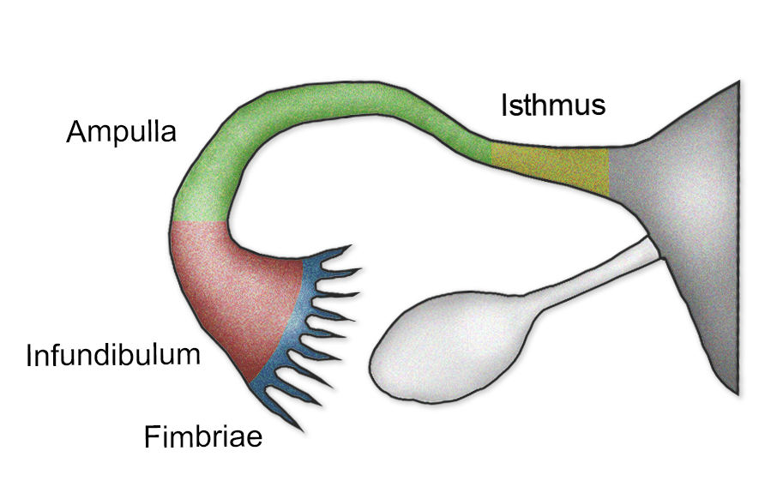
sana Begum, TeachMeAnatomy
The fallopian tubes are comprised of four main parts.

Slide 22
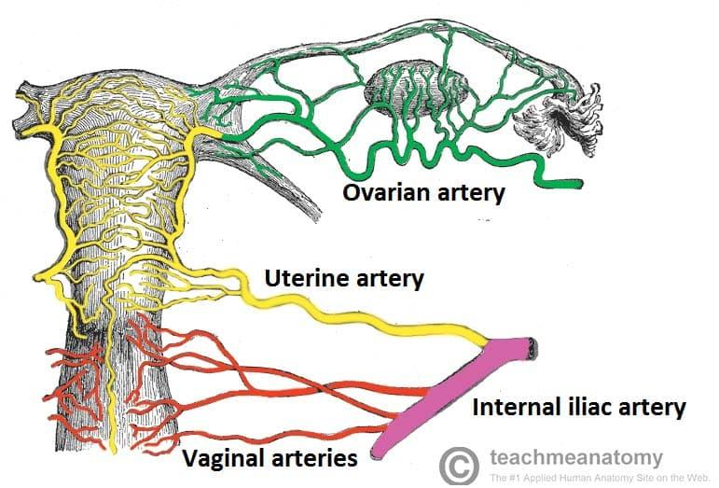
Vascular Supply and Lymphatics
The arterial supply to the uterine tubes is via the uterine and ovarian arteries. Venous drainage is via the uterine and ovarian veins.
Lymphatic drainage is via the iliac, sacral and aortic lymph nodes.
By TeachMe
By TeachMeSerie (2026)
Posterior view of the arterial supply to the female reproductive tract.
Innervation
The uterine tubes receive both sympathetic and parasympathetic innervation via nerve fibres from the ovarian and uterine (pelvic) plexuses. Sensory afferent fibres run from T11- L1.

Slide 23
CLINICAL RELEVANCE
Salpingitis
Salpingitis is inflammation of the uterine tubes that is usually caused by bacterial infection. It can cause adhesions of the mucosa which may partially or completely block the lumen of the uterine tubes. This can potentially result in infertility or an ectopic pregnancy.
Ectopic Pregnancy
If the lumen of the uterine tube is partially occluded, sperm may be able to pass through and fertilise the ovum. However, the fertilised egg may not be able to pass into the uterus – and can implant in the uterine tube. This is known as an ectopic pregnancy.
An ectopic pregnancy is a medical emergency – if not diagnosed early, the implanted blastocyst can cause rupture and haemorrhage of the affected tube.

Slide 24
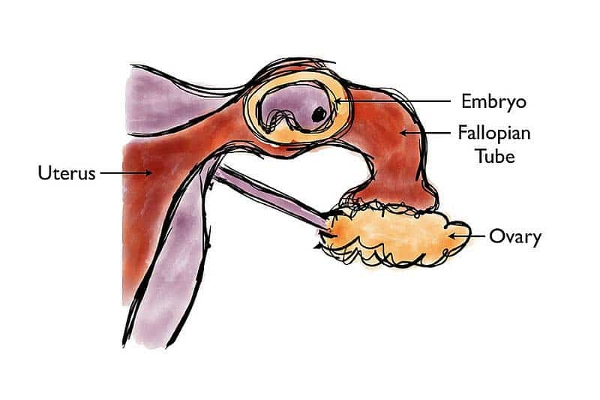
Ligation of the Uterine Tubes
Surgical cutting of the uterine tubes is a method of sterilisation. The oocyte is unable to pass into the uterus, and therefore cannot progress to a pregnancy.
There are two main methods of ligation:
Open abdominal – Carried out via a suprapubic incision
Laparoscopic – Carried out via a fibre optic laparoscope, inserted via a small incision near the umbilicus.
CC-BY-SA-3.0], via Wikimedia Commons
Fig 4
Ectopic pregnancy.
Ectopic pregnancy.

Slide 25
The fallopian tube is comprised of four parts. Which is located most medially?
Fimbriae
Ampulla
Isthmus
Infundibulim
Which of the following provides blood supply to the fallopian tubes?
Vaginal arteries
Pudendal artery
Rectal artery
Ovarian artery
Which of the following is the term for when a fertilised egg implants in the fallopian tube?
Ectopic pregnancy
Placenta praevia
Salpingitis
Ligation of the fallopian tubes

